Slide 1
CptS 327
Crypto History
Notes:
Template-WSU Hrz 201.ppt

Slide 2
Today’s Topics
Overview
  Randomness
  Historic Cryptosystems
  Threats to historic cryptosystems
Notes:
Template-WSU Hrz 201.ppt

Slide 3
Randomness
Used frequently in crypto
  Generates keys, nonces, canaries etc.
Criteria
  Uniformity: random characters must be uniformly distributed
  Independence: each value should be statistically independent from others
  Unpredictability: random text shouldn’t be predictable
Applications
  Encryption (SSL, Public Key, Symmetric Key, Auth protocols)
  Salts
  Unbiased sequencing
Notes:
Template-WSU Hrz 201.ppt

Slide 4
True Randomness
TRNG: True Random Number Generator
Based on truly random process, often based on physical processes
  E.g. rolling dice, flipping a coin, reading thermal noise from a resistor
Intel Ivy Bridge has RdRand instruction that maybe TRNG
Notes:
Template-WSU Hrz 201.ppt

Slide 5
Pseudo Randomness
True randomness is difficult to achieve
PRNG: Pseudo Random Number Generator
  Based on a deterministic algorithm
  Requires a seed value to provide randomness to the algorithm
CSPRNG: Cryptographically Secure Pseudo Random Number Generator
  PRNG that’s made suitable (random enough) for crypto apps
Notes:
Template-WSU Hrz 201.ppt

Slide 6
PRNG in Linux
Linux PRNG: /dev/random and /dev/urandom
Entropy sources
  Translates system events to bits
  Add bits to entropy pool
    Primary, secondary, and universal
  /proc/sys/kernel/random/entropy_avail
Takes an item from the entropy pool, hash SHA-1 thrice
Returns a pseudo random number
Notes:
Template-WSU Hrz 201.ppt

Slide 7
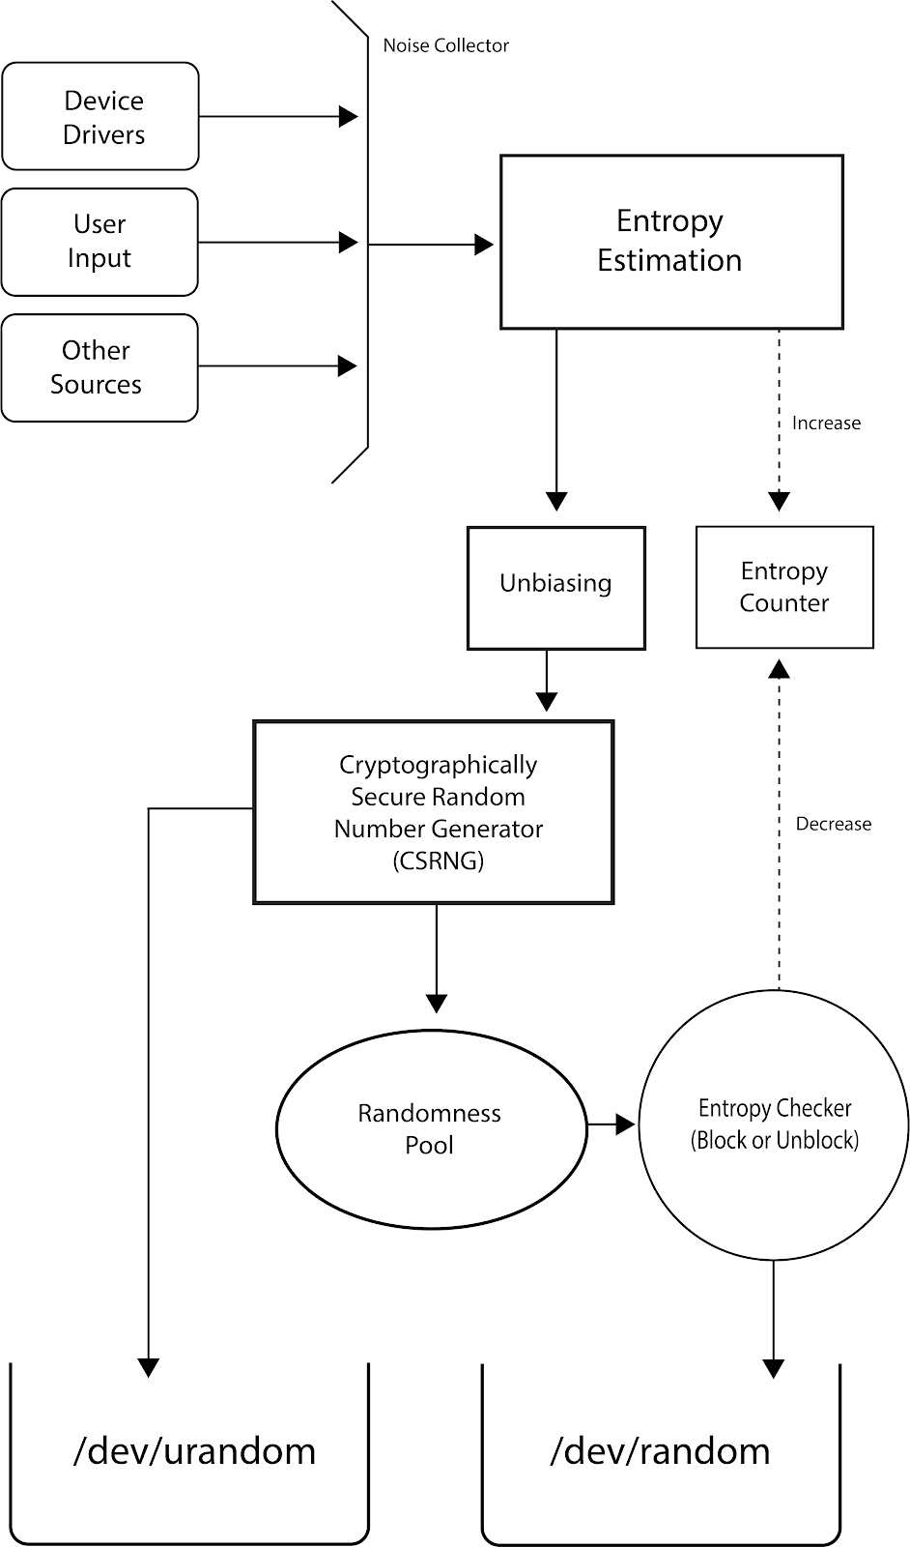

Slide 8
Intel Ivy Bridge: RdRand
Entropy obtained from thermal noise from the processor
Entropy processed by AES and MAC protocols
Resultant random number is sent to a destination register
20x slower than Python CSPRNG
Used to be considered TRNG
Destination register can be compromised (CVE-2020-0543)
Notes:
Template-WSU Hrz 201.ppt

Slide 9
Failures of Randomness
CVE-2008-0166
  Debian OpenSSL 2008 vulnerability
  Caused by a dev accidentally removing randomization code
Mining of keys by Heninger et al.
  5.8 million public keys collected and analyzed
    5.57% of TLS hosts have same keys
    Could predict keys for 0.575% TLS hosts
      Amounts to 333,500 compromised hosts
Notes:
Template-WSU Hrz 201.ppt

Slide 10
Historic Cryptosystems
One Time Pad
Substitution Cipher
Transposition Cipher
Notes:
Template-WSU Hrz 201.ppt

Slide 11
One-Time Pad Cipher
Cipher is a key that is used once and not more
  Encrypt: cipher = (message + key) mod 26
  Decrypt: message = (cipher - key) mod 26
  Key is a predetermined random value that’s shared with trusted parties
    Key should be as long as the message at least
  Provides perfect secrecy if a truly random value is used for the key
    Cannot be cracked
  Key management is a problem
Commonly used throughout 20th century
  US, USSR, Germany
Notes:
Template-WSU Hrz 201.ppt

Slide 12
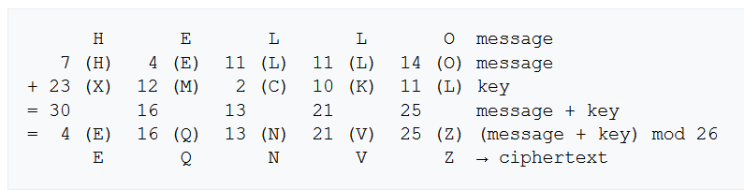
One-Time Pad: Encrypt
Notes:
Template-WSU Hrz 201.ppt

Slide 13
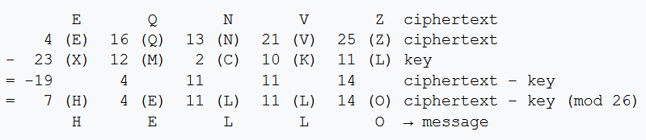
One-Time Pad: Decrypt
Notes:
Template-WSU Hrz 201.ppt

Slide 14
Substitution Cipher
Plain text substituted with cipher text using a key shift
Relatively weak due to a smaller number of possible keys
Susceptible to cryptanalysis attacks due to standard patterns of ciphers
Caesar cipher is an example; used from 108 BCE to 879 CE
Example (shift by 23 letters in English alphabet)
  Plain
  Cipher
T H I S C L A S S I S G R E A T
Q E F P Z I X P P F P D O B X Q
Notes:
Template-WSU Hrz 201.ppt

Slide 15
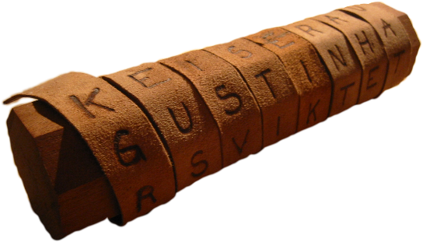
Transposition Cipher
Cipher text is a permutation of the plain text
  Permutation: shuffling; is the key
Relatively weak due to a smaller number of possible keys
Susceptible to cryptanalysis attacks due to availability of plain text in cipher text
Cylinder Cipher is a popular example; used by ancient Greeks
  Paper contains cipher that can be decrypted by using a stick of correct diameter
Plaintext:
A T T A C K A T D A W N
A C D
T A K T A N
T A W
A C D T A K T A N T A W
Encryption:
Ciphertext:
Notes:
Template-WSU Hrz 201.ppt

Slide 16
Next lecture
Symmetric Key algorithms
Notes:
Template-WSU Hrz 201.ppt

Slide 17
Any questions?
Notes:
Template-WSU Hrz 201.ppt

